Slide 1
Physiology of Pain
Dr Reshmy K.R
Professor
Dept.of Physiology
SKHMC

Slide 2
Components of Pain
Pain is defined as an unpleasant sensation and emotional experience associated with or without actual tissue damage.
Types of Pain-Sharp, pricking, electrical, dullache, shooting ,cutting, stabbing, crampy etc
It induces crying and fainting.

Slide 3
Acute pain -sharp pain of short duration with easily identified cause.
It is localized in a small area before spreading to neighbouring areas
Treated by medications.
Chronic pain
The intermittent or constant pain with different intensities.
Lasts for longer periods.
Difficult to treat chronic pain
Needs professional expert care.

Slide 4
Components of Pain sensation
pain sensation has 2 components
Fast pain:
The first sensation whenever a pain stimulus is applied.
Experienced as a bright , sharp and localized pain sensation.
Fast pain is followed by the slow pain, experienced as a dull, diffused and unpleasant pain.
Receptors of pain- free nerve endings.
Afferent nerve fibers are different
Fast pain sensation is carried by Aδ fibers and slow pain sensation is carried by C type of nerve fibers.

Slide 5
Pathway of Pain sensation
1. From skin and deeper structures
Receptors of pain sensation are the free nerve endings which are distributed throughout the body
First Order neurons
-the cells in post. nerve root ganglia, which receives the impulses of pain sensation from pain receptors through their dendrites.
-The impulses are transmitted to spinal cord through the axons of these neurons

Slide 6
Benefits of pain sensation sensation
Pain - sensory symptom
It has protective or survival benefits
1. Pain gives warning signal about the existence of a problem or threat.
It also creates awareness of injury.
2. It prevents further damage by causing reflex withdrawal of the body from the source of injury.
3. Pain forces the person to rest, to minimize the activities -enables rapid healing of injured part.
4. Pain urges the person to take required treatment to prevent major damage.

Slide 7
Fast pain fibers
Fast pain sensation is carried by Aδ type afferent fibers which synapse with neurons of Marginal nucleus in the post. gray horn

Slide 8
Slow pain fibers
Carried by C -type afferent fibers which synapse with neurons of Substantia gelatinosa of Rolando in the post. gray horn

Slide 9
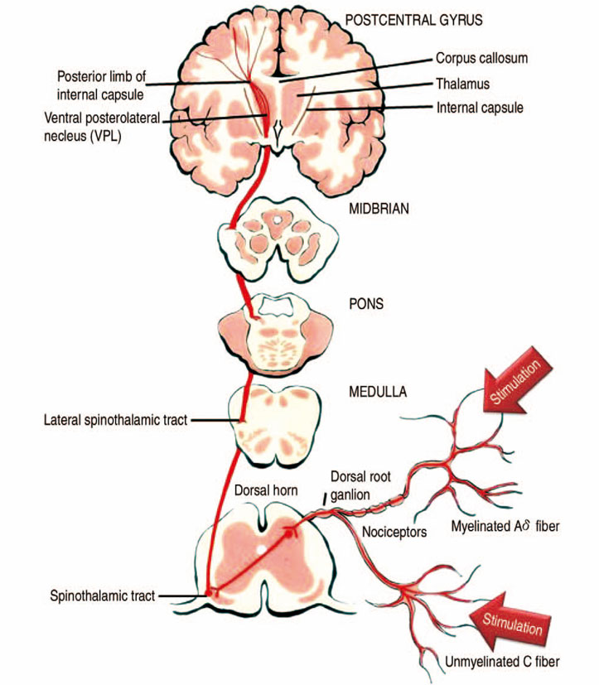
Second Order neurons
Neurons of marginal nucleus and Substantia gelatinosa of Rolando from the second order neurons.
Fibers from these neurons ascend in the form of the Lateral Spinothalamic tract.

Slide 10
Fast pain fibers -long
Fibers of fast pain arise from Neurons of marginal nucleus.
After orgin, the fibers cross the midline via, ant.gray commissure, reach the lateral white column of the opposite side and ascend.
These fibers form the Neospinothalamic fibers -in lateral spinothalamic tract
-these nerve fibers terminate in Ventral posterolateral nucleus of thalamus
Some of fibers terminate in ascending reticular activating system of brainstem

Slide 11
Slow pain fibers
Fibers of slow pain which arise from neurons of Substantia gelatinosa, cross the midline and run along the fibers of fast pain as Paleospinothalamic fibers in lateral spinothalamic tract.
One fifth of these fibers terminate in ventral post.lateral nucleus of thalamus

Slide 12
Remaining fibers terminate in any of the following areas
1. Nuclei of reticular formation in brainstem
2. Tectum of midbrain
3. Gray matter surronding aqueduct of Sylvius

Slide 13
Third order Neurons of pain pathway are the Neurons in
1. Thalamic nucleus
2. Reticular formation
3. Tectum
4. Gray matter around of Sylvius
Axons from these neurons reach the sensory areas of C.C
Some fibers from reticular formation reach hypothalamus

Slide 14
Center for pain senstion- in the postcentral gyrus of parietal cortex
Fibers reaching hypothalamus are concerned with arousal mechanism due to pain stimulus

Slide 15
2. Pain sensation from face is carried by trigeminal nerve
3. From viscera
pain sensation from thoracic and abdominal viscera is transmitted by sympathetic thoracolumbar nerves
pain from esophagus, trachea and pharynx is carried by vagus and glossopharyngeal nerves

Slide 16
4. from pelvic region
pain sensation from deeper structures of pelvic region is conveyed by sacral paraympathetic nerves.

Slide 17
visceral pain
Causes of visceral pain
1.Ischemia- bradykinin and proteolytic enzymes stimulate the pain receptors of viscera
2. Chemical stimuli- acidic gastric juice, leak from ruptured ulcers into peritoneal cavity and produce pain
3. Spasm and overdistention of hollow organs- spastic contraction of smooth muscle in GI T and other hollow organs of viscera cause pain by stimulating the free nerve endings
4.overdistention of hollow organs cause pain

Slide 18
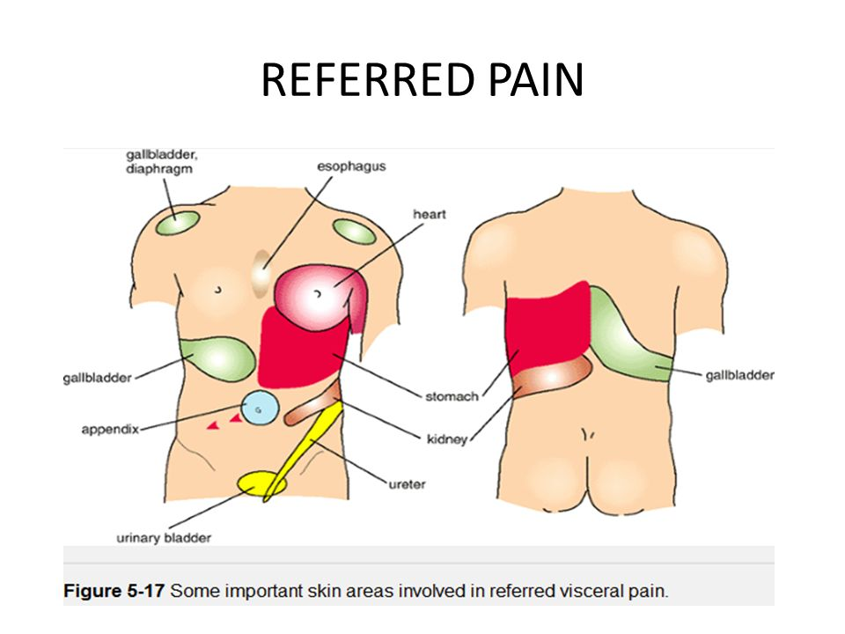
Referred pain
Pain sensation that is perceived at a site adjacent to or away from the site of orgin.
Deep pain and some visceral pain are referred to other areas
superficial pain is not referred
cardiac pain felt at inner part of left arm and left shoulder
pain in ovary is referred to umbilicus
pain from testis is felt in abdomen
pain in diaphragm is referred to shoulder
pain in gall bladder is referred to epigastric region
Renal pain is referred to loin

Slide 19
Mechanism of referred pain
Dermatomal rule
pain is referred to a structure, which is developed from the same dermatome from which pain producing structure is developed.
A dermatome includes all the structues or parts of the body , which are innervated by afferent nerves fibers of one dorsal root.
heart and inner aspect of left arm orginates from the same dermatome- so the pain in heart is referred to left arm

Slide 20
Neuro transmitters involved in pain sensation
Glutamate and substance P are the Neurotransmitters seceted by pain nerve endings.
afferent fibers which transmit impulses of fast pain secrete- glutamate
the C type fibers which transmit impulses of slow pain secrete- substance P

Slide 21
Analgesia system
Analgesia system means the pain control system
Body has its own analgesia system in brain, which provides a short -term relief from pain- Endogenous analgesic system
Analgesia system has got its own pathway through which it blocks the synaptic transmission of pain sensation in spinal cord and thus attenuates the experience of pain
opoids act through this system and provides a controlled pain relief

Slide 22
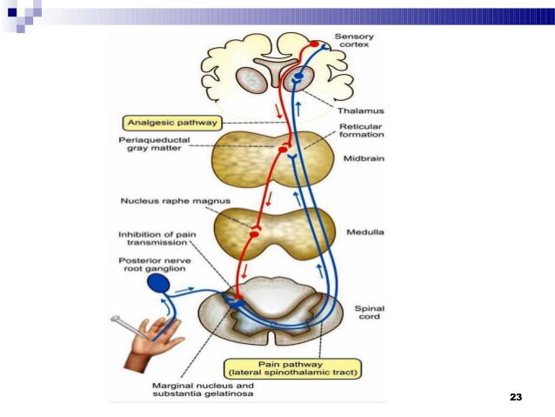
Analgesic pathway
Interfers with pain transmission is often considered as descending pain pathway,
the ascending pain pathway being the afferent fibers that transmit pain sensation to the brain.

Slide 23
Role of Analgesic pathway in inhibiting pain transmission
1. Fibers of analgesic pathway arise from Frontal lobe of C.C and hypothalamus
2. These fibers terminate in the gray matter surrounding the third ventricle and aqueduct of Sylvius
3. Fibers from here descend down to brainstem and terminate on
-Nucleus Raphe magnus, situated in reticular formation of lower pons and upper medulla
-Nucleus reticularis , paragigantocellularis situated in medulla

Slide 24
4. Fibres from the reticular nuclea descent through lateral white coloumn of spinal cord and reach the synapses of the neuron in afferent pathway situated in anterior grey horn
Synapsis of the affarent pain pathway are:
1. Aδ type afferent fibres, neurons of marginal nucleus
2. C type afferent fibres, neurons of substantia gelatinosa of Rolando
5. At synaptic level, analgesic fibres release neuro transmitters - inhibit the pain transmission being related to the brain
- Serotonin, opiates receptor substances - enkephalin, dynorphin, endorphin

Slide 25
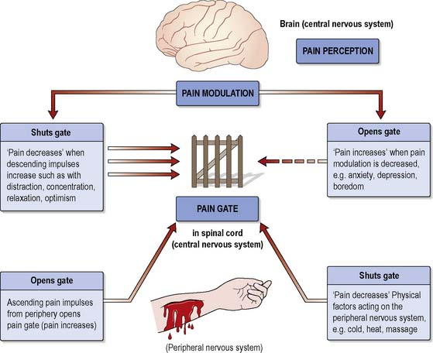
Gate control Theory for pain- explained the pain suppression
Gating system in the CNS opens and closes to allow the pain signals to the brain or to block the signals.
Pain stimuli transmitted by afferent pain fibres are blocked by gate mechanism located at the posterior grey horns of spinal cord
If the gate is opened pain is felt, gate is closed pain is suppressed
When pain stimuli is applied in any part of the body, besides pain receptors, the receptors of other sensation such as touch are also stimulated

Slide 26
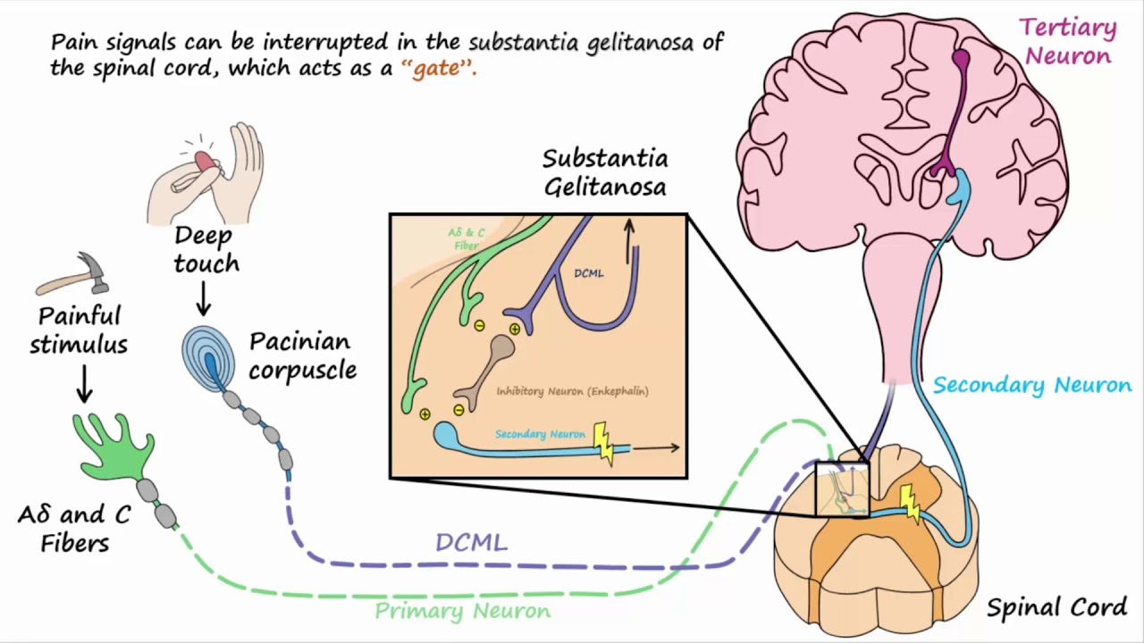
When all these impulses reach the spinal cord through posterior nerve root, the fibres of touch sensation sent collaterals to the neruons of pain pathway - cells of mariginal nucleus and substantia gelatinosa
Impulses of touch sensation pass through these collaterals inhibit the release of glutamate and substance P from the pain fibres
This closes the gate and the pain transmission is blocked

Slide 27
Role of brain in Gate control mechanism
If the gates in spinal cord are not closed, pain stimulus reach thalamus through lateral spino-thalamic tract
These signals are processed in thalamus - to sensory cortex
Perception of pain occurs in cortical level in context of the persons emotional status and previous experiences
Person responds to the pain based on integration of all these information in the brain, thus brain determines the severity and extent of the pain.
To minimse the severity and extent of the pain, the brain sends messages back to spinal cord to close the gate, by releasing pain relievers such as opiate peptides
Pain stimulus is blocked, person feels less pain

Slide 28
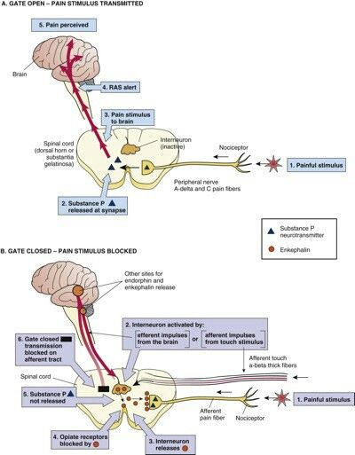
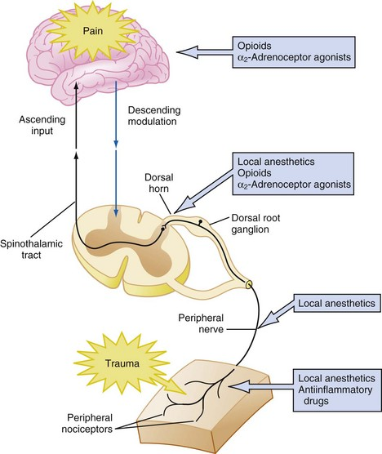

Slide 29
Significance of gate control
Gating of pain at spinal level is similar to pre-synaptic inhibition - basis for relief of pain through rubbing, massaging technique, application of ice packs, acupuncture, electrical analgesia
- Stimulating the release of endogenous pain relievers (opiod peptides) which close the gate and block the pain signals

Slide 30
https://www.youtube.com/watch?v=oQLFfvGM7nI
https://www.nysora.com/files/2013/pdf/(v13p1-10)MultimodalPainManagement.pdf
Thank you

